Slide 1
Big Data Processing
Jiaul Paik
Lecture 14

Slide 2
Spark Fast Big Data Processing

Slide 3
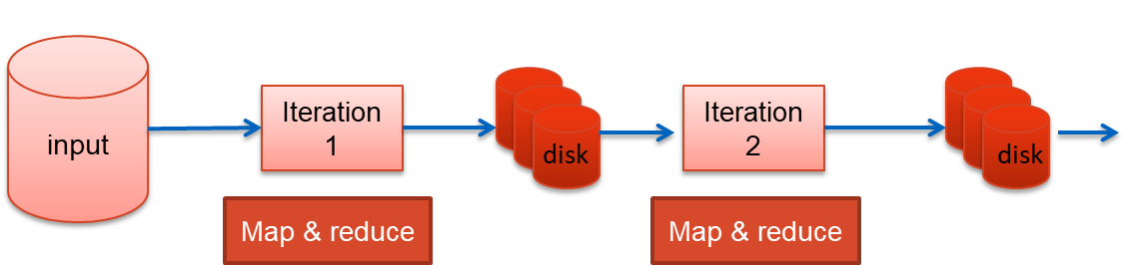
Iterative Algorithm in Map-reduce

Slide 4
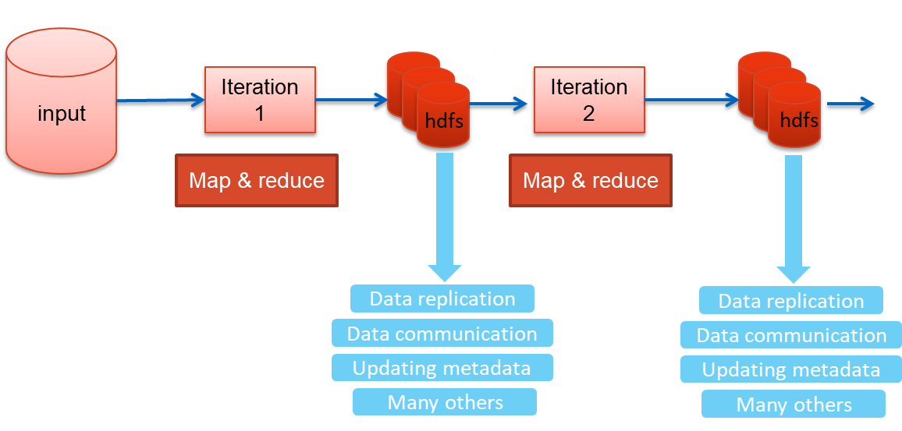
Iterative Algorithm in Map-reduce: Issues

Slide 5
Limitations of basic map-reduce
Good for one-pass computation
But inefficient for multi-pass algorithms
k-means, gradient descent
Spark uses an in-memory distributed data structure to store the data that is repeatedly used
Read-only data structure

Slide 6
Key Concept in Spark for Working with Data
Resilient Distributed Dataset (RDD)
Resilient: can re-compute missing or damaged partitions due to node failures
Distributed: data residing on multiple nodes in a cluster
Dataset: a collection of partitioned data with primitive values (e.g., int, string) or any user defined object (e.g., (word, count) pairs)
RDD of strings
RDD of pairs
(word, count)
am
am, 10
master
master, 5
natural
one element
natural, 7
student
student, 17

Slide 7
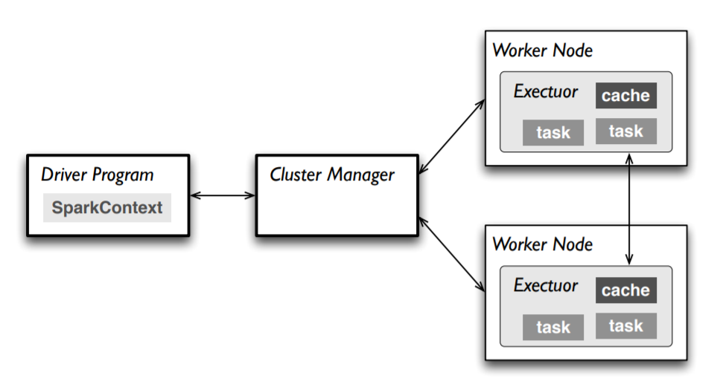
Master
Connects to a cluster manager which allocate resources across applications
Acquires executors on cluster nodes – worker processes to run computations and store data
Sends app code to the executors

Slide 8
Main Steps of an RDD Processing
Create RDD from external data (from distributed file system or local file system)
Transform them to define new RDDs using transformations
map(), filter()
Store in memory any intermediate RDDs that will need to be reused.
persist()
Launch actions to kick off a parallel computation
count()

Slide 9
Creating an RDD
Two ways to do it
By loading an external dataset from disk
Parallelizing a collection in your driver (main) program
val rdd = sc.textFile(“inputFile”)
val lines = sc.parallelize(List("pandas", "i like pandas"))
sc denotes the spark context that calls the spark core and manages the cluster

Slide 10
RDD Operations
Two types of Operations
Transformations
Example: map(), filter()
Actions
Example: count(), saveAsTextFile()

Slide 11
RDD Operations
Transformations
Transformations create a new dataset from an existing one
All transformations in Spark are lazy:
they do not compute their results right away
they remember the transformations applied to some base dataset
the transformed RDD gets recomputed when an action is run on it
Optimizes the required calculations
Recover from the lost data partitions

Slide 12
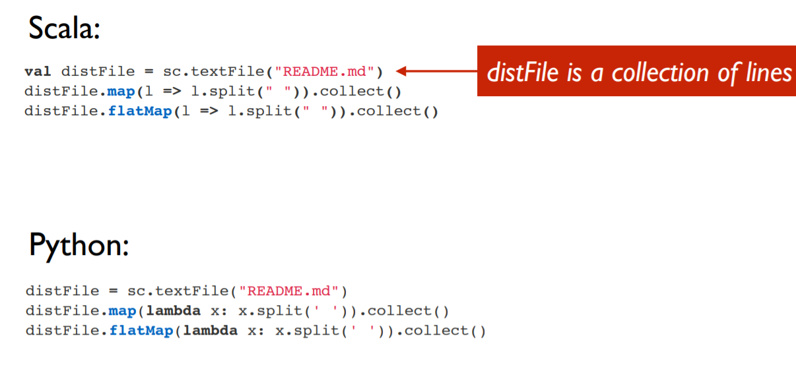
Transformations: Examples

Slide 13
RDD Operations
Actions
Operations that return a result
It kicks off a computation
This is when transformations of RDDs are applied

Slide 14
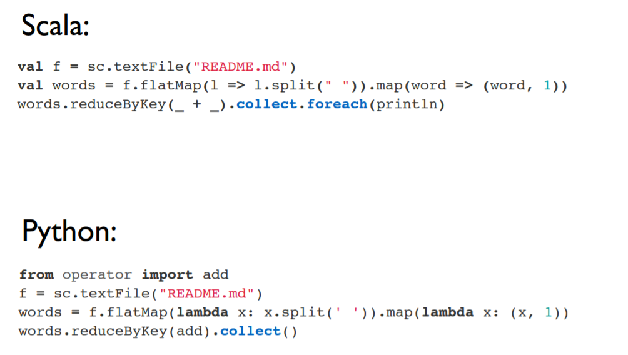
Actions: Examples

Slide 15
Anatomy of an RDD Operation
newRDD = oldRDD.map(….)
creates new RDD from old RDD
and saves in newRDD
User defined code/function

Slide 16
Lazy Evaluation
Spark does not immediately perform an operation
It simply remembers it
Uses a flow graph for memorizing
It kicks off computation if an action operation is requested

Slide 17
An Example Code
data.txt
-------------
I am here
She is there
You are here
val lines = sc.textFile("data.txt")
val lineLengths = lines.map(s => s.length)
val totalLength = lineLengths.reduce((a, b) => a + b)
action

Slide 18
RDD Persistence

Slide 19
RDD Persistence
Spark can persist (or cache) a dataset in memory across operations
Each node stores in memory any slices of it that it computes and reuses them in other actions on that dataset
often making future actions more than 10x faster
The cache is fault-tolerant:
if any partition of an RDD is lost, it will automatically be recomputed using the transformations that originally created it

Slide 20
Persistence (Caching)
Goal is to keep RDD in memory, distributed across machines
Important for iterative computation to increase efficiency
Storage Level | Description
MEMORY_ONLY | Stores RDD in memory
MEMORY_AND_DISK | Store RDD in memory. If RDD does not fit in memory, store the partitions that don't fit on disk, and read them from there when they're needed.
DISK_ONLY | Store the RDD partitions only on disk.
MEMORY_ONLY_2, MEMORY_AND_DISK_2 | Same as the levels above, but replicate each partition on two cluster nodes.
Usage: yourRdd.MEMORY_ONLY

Slide 21
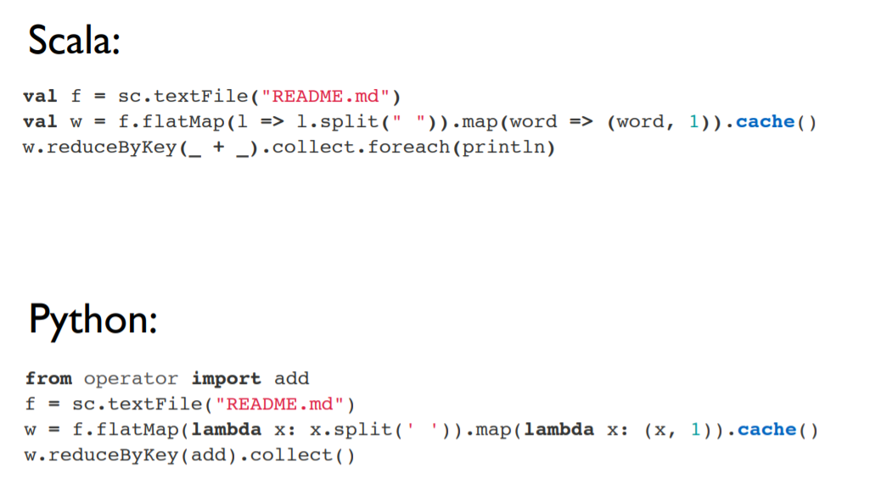
RDD Persistence: Example

Slide 22
Distributed Execution of RDD

Slide 23
Example
Error log mining
Search for various patterns in an error log.
Log file
======
ERROR: java lang.io problem
ERROR: insufficient memory
ERROR: array out of bound

Slide 24
Example
Error log mining
Search for various patterns in an error log.
// load data from file
val lines = sc.textFile("hdfs://...")
// apply transformations
val errors = lines.filter(_.startsWith(“ERROR"))
val messages = errors.map(_.split("\t")).map(r => r(1))
messages.cache()
// perform action 1
messages.filter(_.contains(“java")).count()
// perform action 1
messages.filter(_.contains(“memory")).count()

Slide 25
Example
Error log mining
Search for various patterns in an error log.
worker
// load data from file
val lines = sc.textFile("hdfs://...")
// apply transformations
val errors = lines.filter(_.startsWith(“ERROR"))
val messages = errors.map(_.split("\t")).map(r => r(1))
messages.cache()
// perform action 1
messages.filter(_.contains(“java")).count()
// perform action 2
messages.filter(_.contains(“memory")).count()
driver
worker
worker

Slide 26
RDD Operator Graph
// load data from file
val lines = sc.textFile("hdfs://...")
// apply transformations
val errors = lines.filter(_.startsWith(“ERROR"))
val messages = errors.map(_.split("\t")).map(r => r(1))
messages.cache()
HadoopRDD
FilteredRDD
MappedRDD
MappedRDD

Slide 27
Example
worker
// load data from file
val lines = sc.textFile("hdfs://...")
// apply transformations
val errors = lines.filter(_.startsWith(“ERROR"))
val messages = errors.map(_.split("\t")).map(r => r(1))
messages.cache()
// perform action 1
messages.filter(_.contains(“java")).count()
// perform action 2
messages.filter(_.contains(“memory")).count()
worker
driver
worker

Slide 28
Example
Worker
block 1
// load data from file
val lines = sc.textFile("hdfs://...")
// apply transformations
val errors = lines.filter(_.startsWith(“ERROR"))
val messages = errors.map(_.split("\t")).map(r => r(1))
messages.cache()
// perform action 1
messages.filter(_.contains(“java")).count()
// perform action 2
messages.filter(_.contains(“memory")).count()
Worker
block 2
driver
Worker
block 3

Slide 29
Example
Worker
block 1
// load data from file
val lines = sc.textFile("hdfs://...")
// apply transformations
val errors = lines.filter(_.startsWith(“ERROR"))
val messages = errors.map(_.split("\t")).map(r => r(1))
messages.cache()
// perform action 1
messages.filter(_.contains(“java")).count()
// perform action 2
messages.filter(_.contains(“memory")).count()
Read
hdfs block
Worker
block 2
Read
hdfs block
driver
Worker
block 3
Read
hdfs block

Slide 30
Example
Cache 1
Worker
block 1
// load data from file
val lines = sc.textFile("hdfs://...")
// apply transformations
val errors = lines.filter(_.startsWith(“ERROR"))
val messages = errors.map(_.split("\t")).map(r => r(1))
messages.cache()
// perform action 1
messages.filter(_.contains(“java")).count()
// perform action 2
messages.filter(_.contains(“memory")).count()
Process,
Cache data
Cache 2
driver
Worker
block 2
Process,
Cache data
Cache 3
Worker
block 3
Process,
Cache data

Slide 31
Example
Worker
block 1
// load data from file
val lines = sc.textFile("hdfs://...")
// apply transformations
val errors = lines.filter(_.startsWith(“ERROR"))
val messages = errors.map(_.split("\t")).map(r => r(1))
messages.cache()
// perform action 1
messages.filter(_.contains(“java")).count()
// perform action 2
messages.filter(_.contains(“memory")).count()
Cache 1
driver
Worker
block 2
Cache 2
Worker
block 3
Cache 3

Slide 32
Example
Worker
block 1
Cache 1
// load data from file
val lines = sc.textFile("hdfs://...")
// apply transformations
val errors = lines.filter(_.startsWith(“ERROR"))
val messages = errors.map(_.split("\t")).map(r => r(1))
messages.cache()
// perform action 1
messages.filter(_.contains(“java")).count()
// perform action 2
messages.filter(_.contains(“memory")).count()
driver
Worker
block 2
Cache 2
Worker
block 3
Cache 3

Slide 33
Example
Cache 1
Worker
block 1
Process from cache
// load data from file
val lines = sc.textFile("hdfs://...")
// apply transformations
val errors = lines.filter(_.startsWith(“ERROR"))
val messages = errors.map(_.split("\t")).map(r => r(1))
messages.cache()
// perform action 1
messages.filter(_.contains(“java")).count()
// perform action 2
messages.filter(_.contains(“memory")).count()
Cache 2
driver
Worker
block 2
Process from cache
Cache 3
Worker
block 3
Process from cache

Slide 34
RDD Operations: Examples

Slide 35
Example of Basic RDD Transformations: Single RDD
RDD containing {1,2,3,3}
Function | Description | Example | Result
map() | Apply a function to each element in the RDD and return an RDD of the result | rdd.map(x => x + 1) | {2, 3, 4, 4}
flatMap() | Apply a function to each element in the RDD and return an RDD of the contents of the iterators returned. | rdd.flatMap(x => x.to(3)) | {1, 2, 3, 2, 3, 3, 3}
filter | Return an RDD consisting of only elements that pass the condition passed to filter(). | rdd.filter(x => x != 1) | {2, 3, 3}
distinct | Remove duplicates. | rdd.distinct() | {1, 2, 3}
sample(withRe placement, frac tion, [seed]) | Sample an RDD, with or without replacement. | rdd.sample(false, 0.5) | Nondeterministic

Slide 36
Example of Basic RDD Actions
RDD containing {1, 2, 3, 3}
Function | Description | Example | Result
collect() | Return all elements from the RDD. | rdd.collect() | {1, 2, 3, 3}
count() | Number of elements in the RDD. | rdd.count() | 4
top() | Return the top num elements the RDD. | rdd.top(2) | {3, 3}
countByValue() | Number of times each element occurs in the RDD. | rdd.countByValue() | {(1, 1), (2, 1), (3, 2)}
reduce() | Combine the elements of the RDD together in parallel (e.g., sum). | rdd.reduce((x, y) => x + y) | 9

Slide 37
Example of Basic RDD Transformations: Two RDD
Two-RDD transformations on RDDs containing {1, 2, 3} and {3, 4, 5}
Function | Description | Example | Result
union() | Produce an RDD containing elements from both RDDs. | rdd.union(other) | {1, 2, 3, 3, 4, 5}
intersection() | Common elements | rdd.intersection(other) | {3}
subtract() | Remove the contents of one RDD | rdd.subtract(other) | {1, 2}
Cartesian() | Cartesian product with the other RDD. | rdd.cartesian(other) | {(1,3), (1,4), …}

Slide 38
Paired RDD: Transformations
RDD containing key-value pairs
The fundamental concept behind original map-reduce model
Transformations on one paired RDD containing {(1, 2), (3, 4), (3, 6)}
Function | Description | Example | Result
reduceByKey(func) | Combine values with the same key. | rdd.reduceByKey( (x, y) => x + y) | {(1,2), (3,10)}
groupByKey() | Group values with the same key. | rdd.groupByKey() | {(1,[2]),(3, [4,6])}
mapValues(func) | Apply a function to each value of a pair RDD without changing the key. | rdd.mapValues(x => x+1) | {(1,3), (3,5), (3,7)}
keys() | Return an RDD of just the keys. | rdd.keys() | {1, 3,3}
values() | Return an RDD of just the values. | rdd.values() | {2, 4,6}
sortByKey() | Return an RDD sorted by the key. | rdd.sortByKey() | {(1,2), (3,4), (3,6)}

Slide 39
Paired RDD: Actions
RDD containing {(1, 2), (3, 4), (3, 6)}
Function | Description | Example | Result
countByKey() | Count the number of elements for each key. | rdd.countByKey() | {(1, 1), (3, 2)}
lookup(key) | Return all values associated with the provided key. | rdd.lookup(3) | {4,6}

Slide 40
Two Paired RDD: Transformations
Transformations on two paired RDDs: (rdd = {(1, 2), (3, 4), (3, 6)}, other = {(3, 9)})
Function | Description | Example | Result
join | Perform an inner join between two RDDs. | rdd.join(other) | {(3, (4, 9)), (3, (6, 9))}
cogroup | Group data from both RDDs sharing the same key. | rdd.cogroup(other) | {(1,([2],[])), (3, ([4, 6],[9]))}

Slide 41
Controlling Partitions in RDD (controlling parallelism)

Slide 42
Partitioning RDDs
Goal
control how data will be physically distributed across the cluster
You can reduce the number of partition
You can increase the number of partition

Slide 43
Partitioning RDDs
coalesce
collapses partitions on the same worker
Example:
words.coalesce(1) // # partition reduces to 1

Slide 44
Partitioning RDDs
repartition
allows you to repartition your data up or down
but performs a shuffle across nodes in the process.
Increasing the number of partitions can increase the level of parallelism
Example:
words.repartition(10) // gives us 10 partitions

Slide 45
Partitioning RDDs
Inbuilt Partitioner
Spark supports two inbuilt partitioner
HashPartitioner (for discrete values)
RangePartitioner (for continuous values)

